Slide 1
Mobile Development
By: Thomas Morris, David Savrda, and Alexander White

Slide 2

Quality in Mobile Development
Measure of functional and aesthetic utility to the consumer

Slide 3
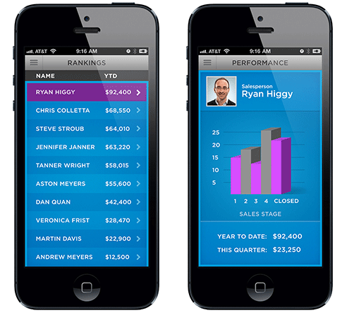
Important factors in QA
Stable and Reliable
Platform Consistency
Loads fast
No Blocking UI

Slide 4
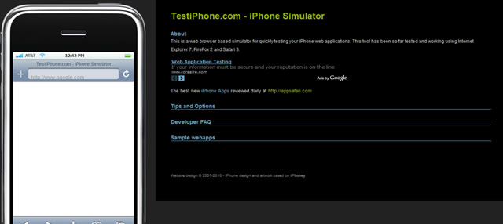
Processes Used in Mobile Dev.
Functional Testing
Configuration Testing
Usability Testing

Slide 5
Metrics
Behavioral analytics
Attitudinal analytics
Average number of keystrokes and clicks
Search function usage
Drive tests
Monitoring Network Signaling

Slide 6
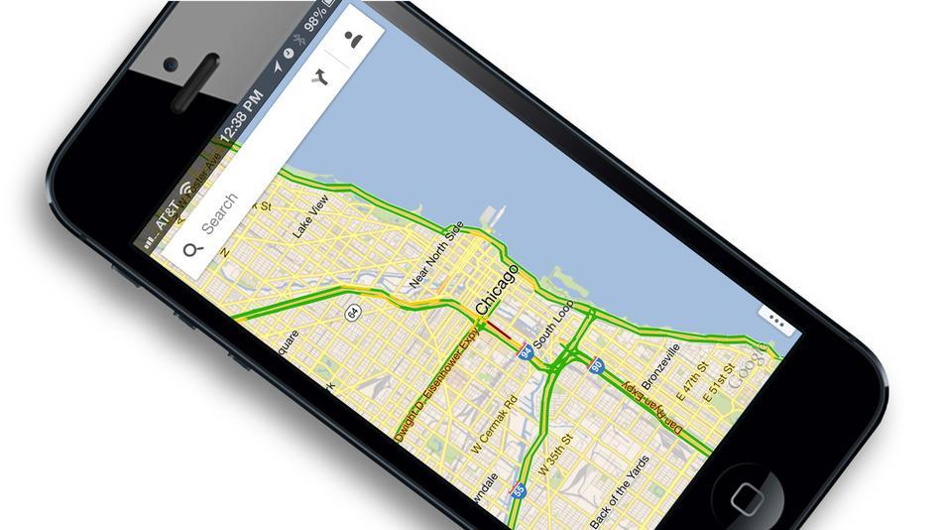
Successes in Mobile Development
Healthcare
iPads and iPhones
Google Maps(app)

Slide 7

Failures in Mobile Development
The Zune
Apple Newton
BlackBerry PlayBook

Slide 8
Common problems with QA
Usability
Device heterogenity
Network limitation

